Slide 5
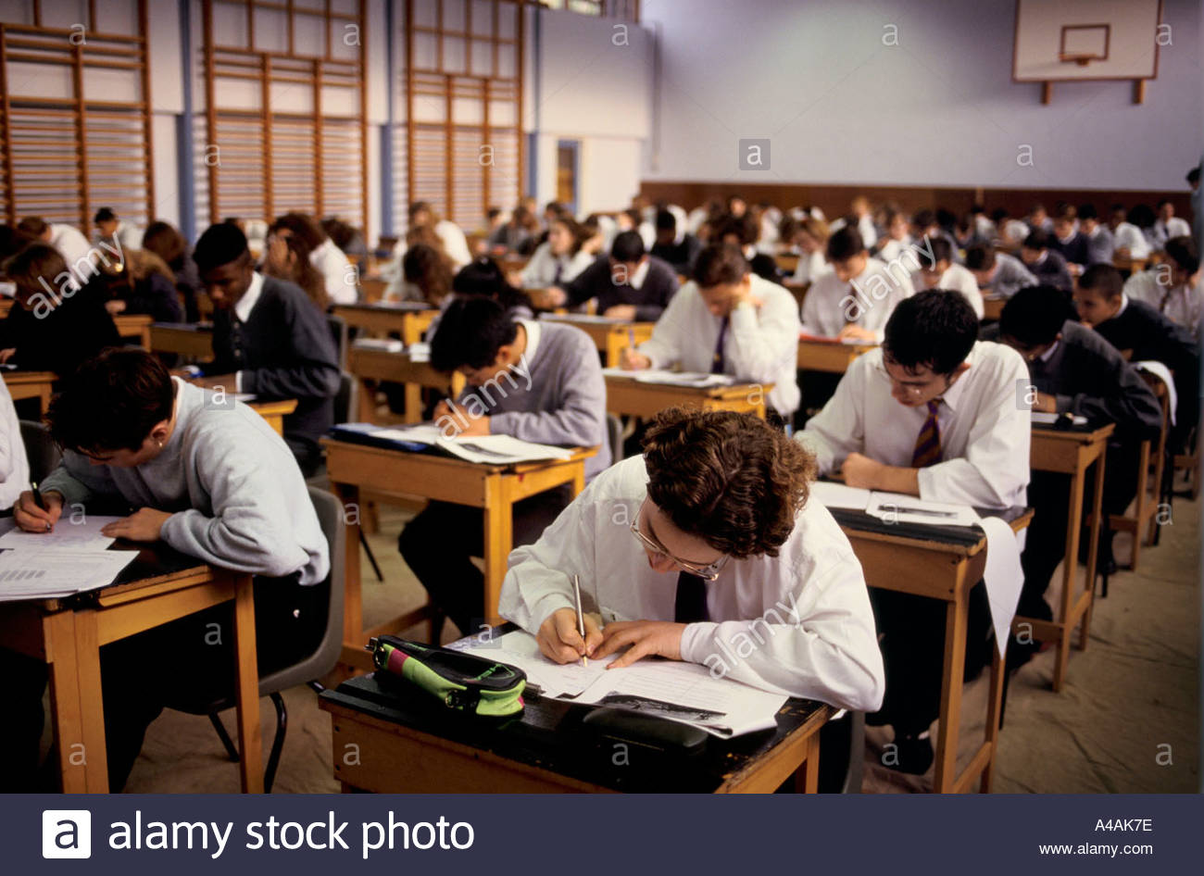
COMPONENT 1 & 2 are tested with 2 written exams sat in Year 12. Book learning is part of GCSE PE course.

Slide 6
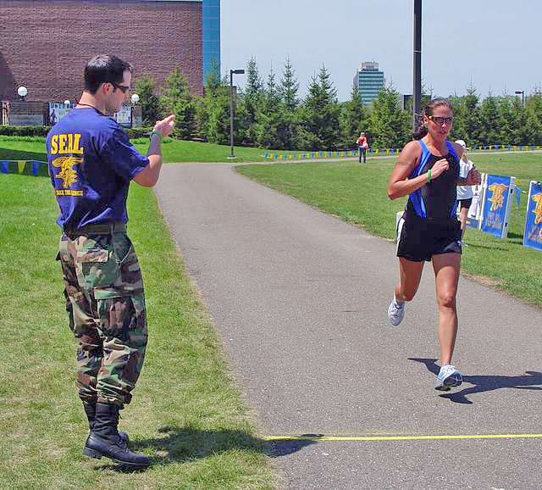
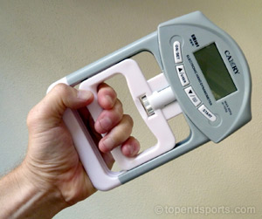
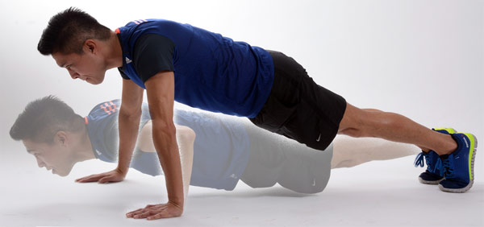
COMPONENT 3: -FITNESS TESTING MUST BE DONE BY ALL GCSE STUDENTS AS A COURSEWORK COMPONENT. (baseline fitness – be able to run 1.5miles (2300m) in 12 minutes)

Slide 7
ON SITE ACTIVITIES – AT LEAST ONE MUST BE PICKED FROM THOSE BELOW. You can pick two from this section.

Slide 8
OFF SITE ACTIVITIES. – Only one may be selected (if needed). This must be agreed with PE Staff before you start the course. Below are some done by past pupils.

